Slide 1
Computer Architecture Concepts
Part 10 – Arithmetic Logic Unit (ALU)

Slide 2
Objectives
To give a brief introduction to the concept of an ALU

Slide 3
ALU
The Arithmetic Logic Unit is the part of a computer processor that carries out instructions on the binary data
Different computer processor families will have different operations available and could include:
Add
Bitwise AND, OR, NOT etc
Shift all the bits in an input
Often all the available instructions will be done in parallel and the relevant result selected to pass to the output

Slide 4
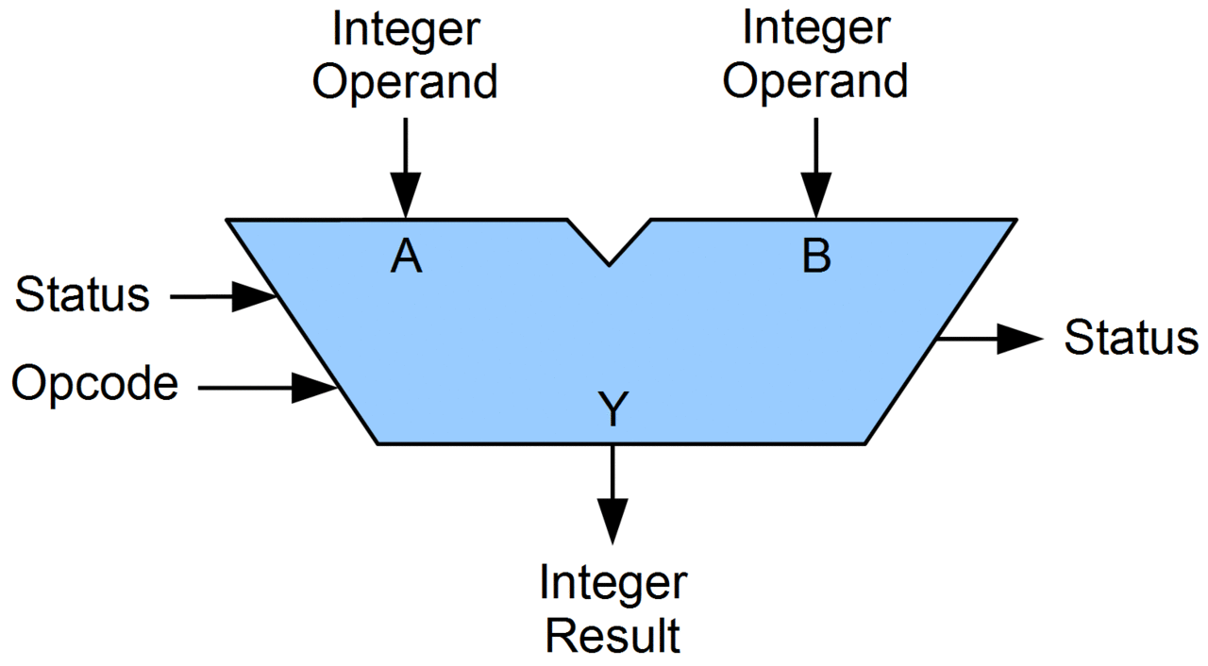
ALU
The ALU takes two operands (A and B)
Binary signals to carry out an operation on
There is an input Opcode
Binary signals as a code for which operation is needed
The output is the result of carrying out the operation on A and B
There may be output status / condition code indicators
Image credit: By Lambtron - Own work, CC BY-SA 4.0,
https://commons.wikimedia.org/w/index.php?curid=36975996

Slide 5
Summary
The ALU is a component that can carry out multiple operations on two inputs.

